Slide 1
What is the effect of Temperature on Shared Bike Demand in the London market ?
Notes:
Line spacing + Page numbers

Slide 2
Abstract
In this study, we present a comprehensive analysis of the weather factors influencing bike sharing usage in London. Utilizing a rich dataset encompassing hourly records of bike sharing counts along with environmental and temporal variables, This project aims to dissect the key drivers behind the fluctuating demand for bike sharing in ths urban landscape. Utilizing detailed hourly data, the analysis focuses on how environmental variables like temperature, humidity, and weather conditions, along with temporal factors such as weekends and holidays, affect bike sharing usage. Through linear regression and time series analysis, the project explores both linear and non-linear relationships between these variables and bike sharing counts. The findings provide valuable insights into the dynamics of urban bike sharing, highlighting the significant role of weather and time-related factors. This research offers practical implications for urban transportation planning and the promotion of sustainable mobility solutions.

Slide 3
Introduction
In this study, we examine the factors influencing bike sharing demand in London during 2016, focusing on environmental and temporal variables. The aim is to understand how aspects like weather conditions and days of the week affect people's bike sharing choices. This research is crucial for enhancing urban mobility strategies and promoting sustainable transportation.
Our method involves analysing hourly bike sharing data alongside weather and time-related information, using linear regression and time series analysis. This approach allows us to delve into the complex relationship between these factors and bike sharing usage.
Previous studies have highlighted the importance of environmental and urban dynamics in shaping bike sharing trends. Building upon this, our analysis offers new insights, particularly for London's unique urban setting. We find that weather conditions significantly influence bike sharing, reflecting broader trends in outdoor activities, while variations on weekends and holidays point to differing usage patterns for commuting and leisure.
Overall, this project sheds light on key drivers of bike sharing in London, providing valuable information for urban planners and contributing to the broader discussion on sustainable urban transportation.

Slide 4
Data Description
The primary data source is an hourly record of bike sharing counts along with environmental and temporal variables.
Variables: Timestamp, Cnt, Temperature Variables (t1, t2),Humidity (hum),Wind Speed, Weather Code, Is_holiday, Is_weekend, Season, Additional Variables
The dataset originally presents a panel data structure, recording multiple variables across different time points. We transformed this into a cross-sectional dataset to focus on specific time points for our analysis. This transformation involved aggregating hourly data into larger time frames where necessary and ensuring consistency across different variables.
Our preliminary exploratory analysis included generating summary statistics and exploratory graphs. This process helped us understand the distribution of key variables, identify any outliers or anomalies, and assess the need for data cleaning. It also provided initial insights into potential relationships between variables, guiding our subsequent regression analysis.

Slide 5
Econometric Model
Dependent Variable: Bike sharing count (cnt).
Independent Variables: Temperature (t1, t2), humidity (hum), wind speed, weather conditions, Is_holiday, Is_weekend, and season.
Primary Method: Linear Regression Analysis.
Purpose: To estimate the relationship between bike sharing counts and selected independent variables.
Functional Form:
Linear Model: Initial approach to understand direct relationships.
Consideration for Non-Linearity: To explore more complex relationships, potential inclusion of polynomial terms or interaction effects.
Reason for Choice: Linear models provide a clear, interpretable baseline. Adjustments for non-linearity or interactions allow for a more nuanced understanding of the data.
Model Evolution:
From Simple to Complex: Starting with basic models, progressively adding variables to understand their individual and combined effects.
Diagnostic Tests: Conducted to ensure model validity and to refine model specifications.
Additional Considerations:
Time Series Analysis: If applicable, to address any autocorrelation due to the temporal nature of the data.
Panel Data Techniques: Consideration for fixed or random effects if analysing panel data structure.

Slide 6
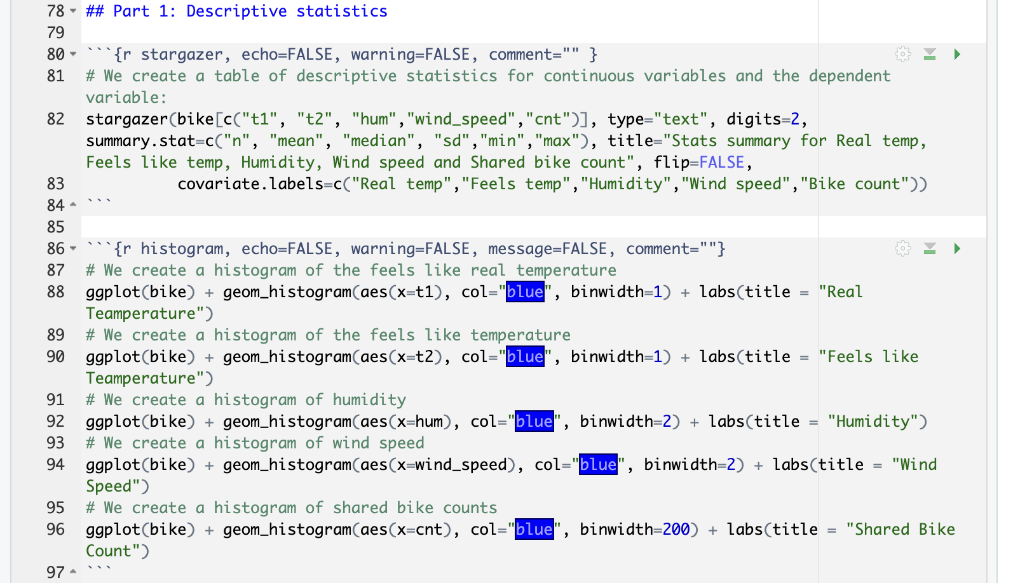
Part 1: Descriptive statistics
The histograms for key variables in our bike sharing dataset show:
Real Temperature: normally distributed around a mean of 12.38°C.
Feels Like Temperature: Bimodal distribution, indicating varied perception of temperatures.
Humidity: Left-skewed, suggesting higher humidity levels are more common.
Wind Speed: Right-skewed, with most days having moderate wind.
Shared Bike Count: Right-skewed, with occasional peaks indicating days of high usage.
These distributions indicate diverse environmental conditions and bike usage patterns, with the variability in 'feels like' temperature and bike counts suggesting the influence of additional factors or specific events. The analysis suggests that temperature, both real and perceived, along with humidity and wind speed, could be significant predictors of bike sharing demand, warranting further investigation through regression analysis that accounts for non-linear relationships.

Slide 7
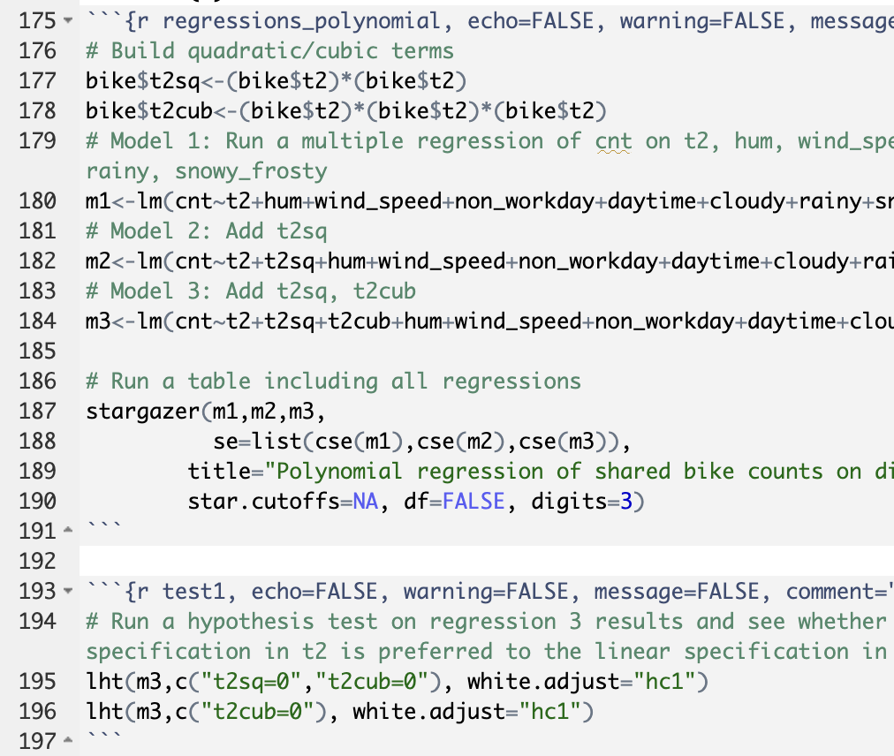
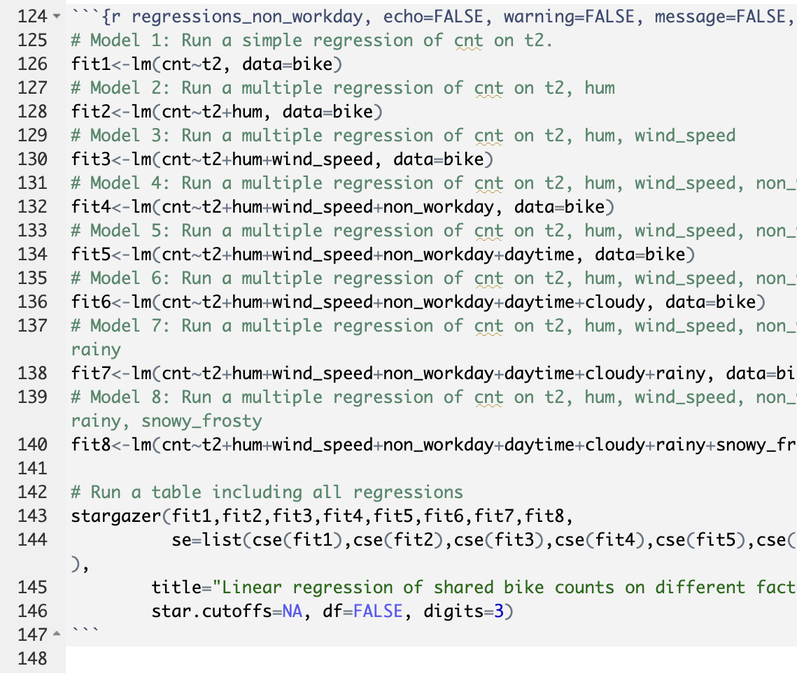
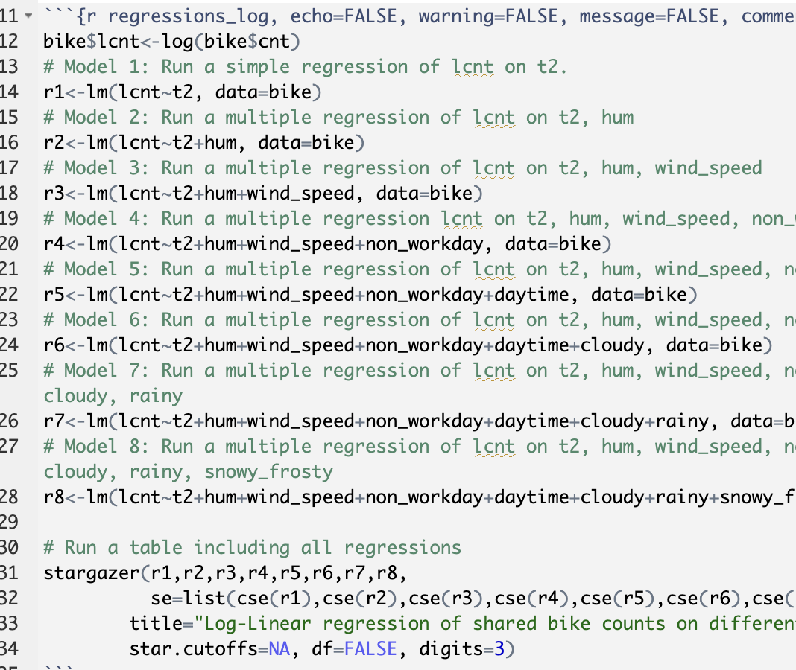
Part 2: Baseline Regression Analysis
From the analysis, we can conclude that both the real and 'feels like' temperature have a significant positive impact on bike sharing demand, with the relationship being non-linear. Humidity and adverse weather conditions, such as rain, tend to decrease bike sharing, while daylight hours increase usage. The complexity of these relationships is captured better by non-linear and log-linear models, which adjust for the skewness and potential multiplicative effects in the data. While the regression models offer significant insights, they also come with caveats. The presence of unobserved factors, potential measurement errors, and the assumption that past patterns will predict future behaviours can affect the internal and external validity of the analysis. The findings are specific to the London context and may not generalize to other cities or times. It’s also important to consider that the causal effect may be confounded by variables not included in the model.

Slide 8
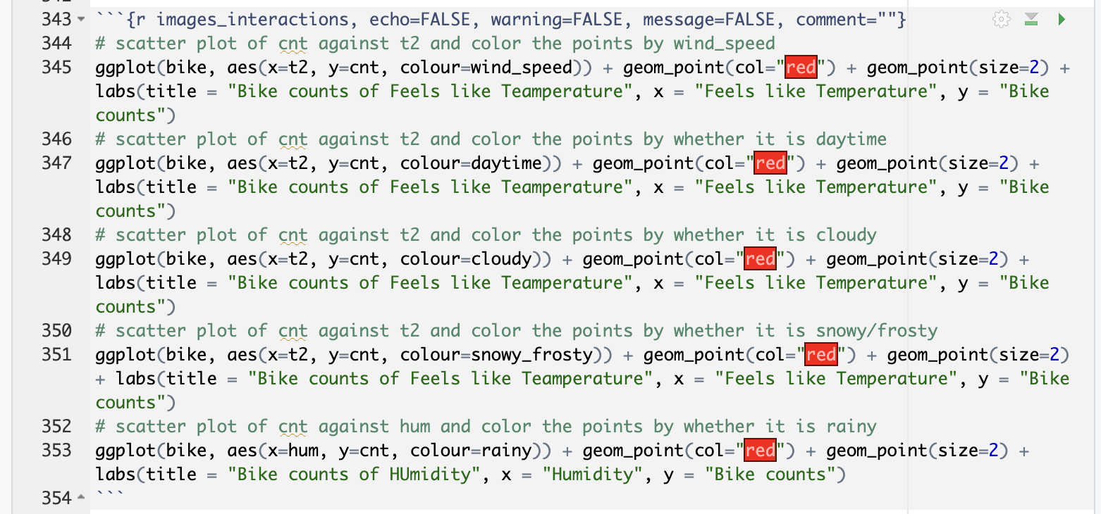
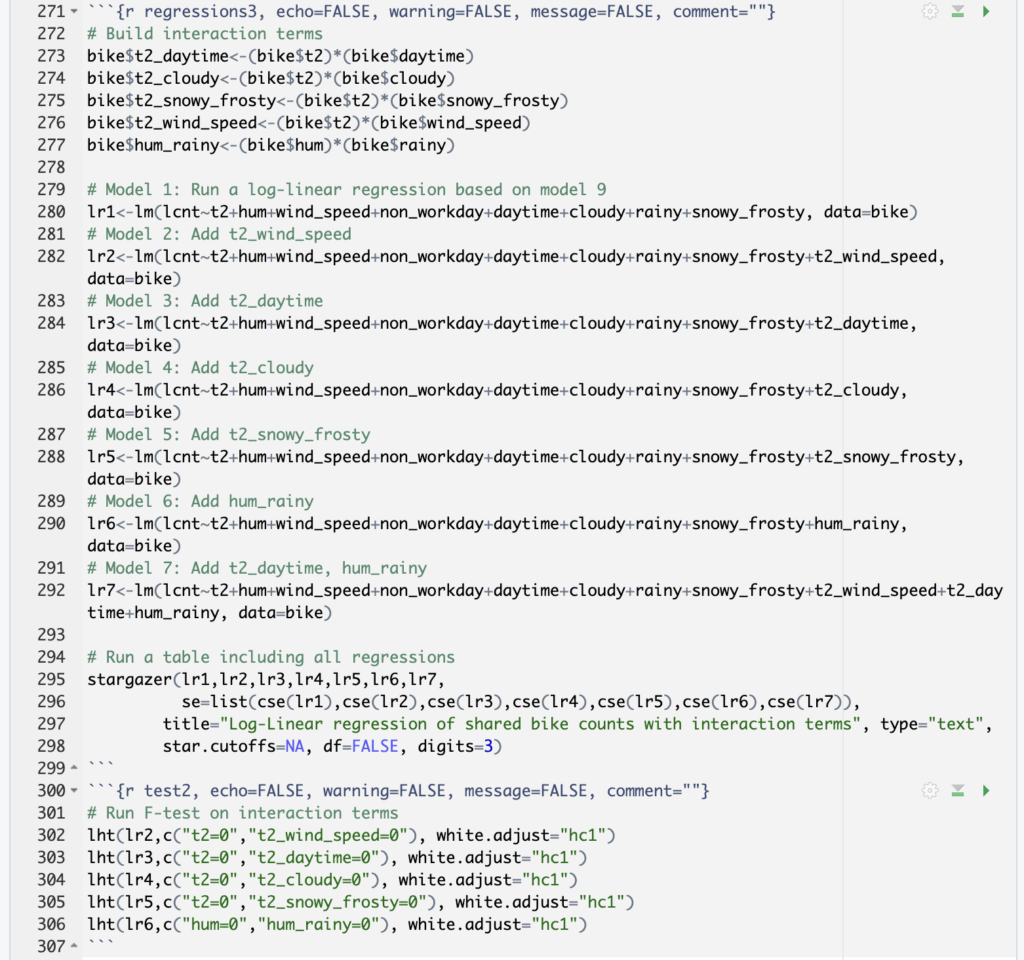
Part 3: Alternative Regression Specification
In "Part 3: Alternative Regression Specification," log-transformed non-linear regressions and polynomial terms reveal complex relationships in bike sharing demand:
Non-linearity: Log transformations and polynomial regressions capture the non-linear effects of temperature, with significant coefficients indicating an increase in bike sharing with warmer 'feels like' temperatures.
Interaction Terms: The inclusion of interaction terms between temperature and variables like wind speed and daytime indicates these factors' conditional effects on bike sharing.
F-Tests: F-tests favour more complex quadratic or cubic models over linear ones, confirming their better fit and suggesting a more accurate reflection of the real-world dynamics.
Interpretation and Sensitivity: Coefficients have expected signs and are statistically significant. The sensitivity of results to different model specifications underscores the robustness of the findings, with variations in specifications providing consistent economic insights into the factors affecting bike sharing.

Slide 9
Part 4: Conclusion
In our analysis of bike sharing in London using regression models, we examined variables like temperature, humidity, wind speed, and various weather conditions, uncovering the complex dynamics influencing bike sharing demand. Our study highlighted a particularly intricate, non-linear relationship between 'feels like' temperature and bike sharing counts, as revealed by polynomial regression models. F-tests supported the use of these models over simpler linear ones, although the increase in explanatory power was modest. The right-skewed distribution of bike sharing counts led us to consider logarithmic transformations, indicating the potential for log-linear relationships. Visual analysis through scatterplots further illustrated these complex correlations, especially the significant role of temperature. Overall, our research provides a nuanced understanding of the factors driving bike sharing in London, emphasizing the complex and non-linear nature of these relationships, while also acknowledging the limitations inherent in such models.

Slide 10
Limitations
Omitted Variable Bias (Internal Validity):
Potential overlook of influential factors like socioeconomic status or specific urban infrastructure.
May impact the accuracy of causal relationships derived from the analysis.
Specificity to London's Context (External Validity):
Findings tailored to London's urban environment in 2016, limiting applicability to other cities or time periods.
Variations in environmental, cultural, and infrastructural aspects can affect the relevance of results elsewhere.
Data Reliability:
Dependence on the accuracy and consistency of the data collection process.
Possible inconsistencies or errors in data reporting could influence the study's outcomes.
Generalizability Constraints:
Caution advised in extending conclusions beyond the specific context and time frame of the study.
Results may not accurately represent bike sharing dynamics in differing urban settings or future scenarios.

